Slide 1
Multimedia Systems Lecture – 13
By
Dr. Priyambada Subudhi
Assistant Professor
IIIT Sri City

Slide 2
Types of Video Signals
Composite Video
Composite video is also called baseband video or RCA video. It is the analog waveform that conveys the image data in the conventional NTSC, PAL and SECAM television signal.
Composite video contains both chrominance (color) and luminance (brightness) information, along with synchronization and blanking pulses, all together in a single signal.
This was done to reduce bandwidth and achieve real-time transmission.
However, in composite video, interference between the chrominance and luminance information is inevitable and tends to worsen when the signal is weak.
This is why fluctuating colors, false colors, and intensity variations are seen when a distant NTSC television station sends signals that are weak and not properly captured at home with old-fashioned “rabbit ears,” or outdoor “aerial” antennae.

Slide 3
S-Video
S-Video (Super-Video, sometimes referred to as Y/C Video) is a video signal transmission in which the luminance signal and the chrominance signal are transmitted separately to achieve superior picture clarity.
The luminance signal (Y) carries brightness information, and the chrominance signal (C) carries color information.
Here, the chrominance signal (C) is formed by combining the two chrominance signals U and V into one signal along with their respective synchronization data, so at display time, the C signal can be separated into U and V signals.
Separating the Y and C channels and sending them separately reduces problems caused by interference between the luminance and chrominance signals and yields a superior visual quality.

Slide 4
Component Video
Component video strives to go a step further than S-Video by keeping all three Y, U, V (or equivalent) components separate.
Consequently, the bandwidth required to broadcast component video is more than the composite or S-Video and, correspondingly, so is the visual quality.
The separation of these components prevents artifacts due to intersignal interference.

Slide 5
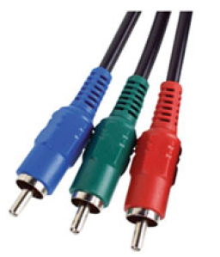
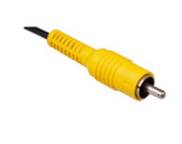
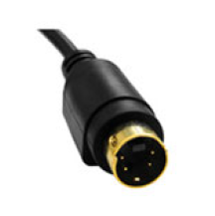
Connectors for typical analog display interfaces. From left to right:, Composite video, S-video, and Component video

Slide 6
Digital Video
The advantages of digital representation for video are many. It permits
Storing video on digital devices or in memory, ready to be processed (noise removal, cut and paste, and so on) and integrated into various multimedia applications.
Direct access, which makes nonlinear video editing simple.
Repeated recording without degradation of image quality.
Ease of encryption and better tolerance to channel noise.

Slide 7
YUV Subsampling Schemes
Video signals captured by digital cameras are represented in the RGB color space, which is also used to render video frames on a display device.
However, for transmission and other intermediary processing, the YUV space is commonly used.
The YUV space separates the color and luminance information.
The color information (UV) is then further subsampled to gain more bandwidth.
In analog video, subsampling is achieved by allocating half as much bandwidth to chrominance as to luminance.
In digital video, subsampling can be done by reducing the number of bits used for the color channels on average.

Slide 8
Depending on the way subsampling is done, a variety of subsampling ratios can be achieved.
The circles represent pixel information.
Potentially, we could store 1 byte each for Y, U, and V components, resulting in 24 bits per pixel.
In subsampling, the luminance component Y is left untouched—that is, 1 byte is reserved for the luminance data per pixel.
An X at a pixel position suggests that we also store the chrominance components for this position.

Slide 9
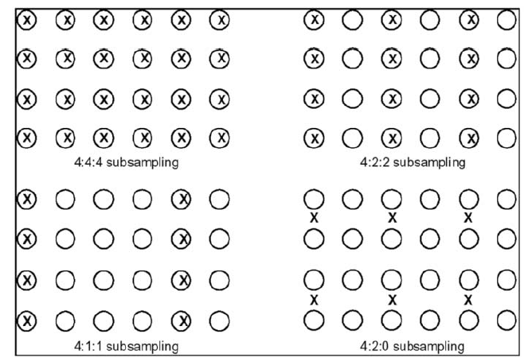
YUV subsampling schemes used in video

Slide 10
In the 4:4:4 scheme, each pixel has luminance (8 bits) and chrominance (8 bits for U and 8 bits for V), resulting in 24 bits per pixel.
In the 4:2:2 subsampling scheme, chrominance information is stored for every other pixel bringing the equivalent bits per pixel down to 16.
In the 4:1:1 subsampling scheme, chrominance is stored every fourth pixel in a row.
Whereas in the 4:2:0 scheme, the average of the U values for a 2×2 pixel area is stored, and similarly for the V values.
Since there is only 1 U and 1 V sample for every four luminance samples, the equivalent bits per pixel is brought down to 12 bits per pixel.

